Slide 1
Stock Sentimental Analysis Based On News Headline
Imarticus Learning
ML Project
Name – Ranjan Khamari Batch-PGAA UCLA Batch -3

Slide 2
Contents
Imarticus Learning
Introduction
Problem Statement
Objective
Dataset Overview
Workflow/Methodology
Conclusion
Business Aspects

Slide 3
Introduction
Imarticus Learning
A stock is a type of investment that represents an ownership share in a company. Investors buy stocks that they think will go up in value over time.
For companies, issuing stock is a way to raise money to grow and invest in their business. For investors, stocks are a way to grow their money and outpace inflation over time.
Negative news headlines will normally cause people to sell stocks. A bad earnings report, a lapse in corporate governance, big-picture economic and political uncertainty, and unfortunate occurrences all translate to selling pressure and a decrease in the prices.
Positive news headlines will normally cause individuals to buy stocks. Good earnings reports, an announcement of a new product, a corporate acquisition, and positive economic indicators all translate into buying pressure and an increase in stock prices.
In this project our aim to predict whether the stock prices go up or down based upon the top news headlines.

Slide 4
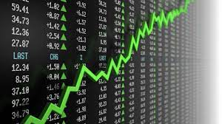
Problem Statement
Imarticus Learning
How stock prices will be affected based on top news headlines

Slide 5

Objective
Imarticus Learning
Objective of this model is to come up with a strong machine learning model which will predict whether price of the stock will go up or down based on the news headlines using previous data.

Slide 6
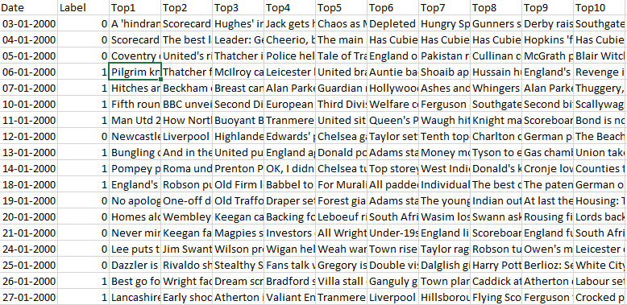
Datasets Sample
Imarticus Learning
Basically , this dataset contain ‘Dates from 2000 to 2016’ ,’Top 25 news headlines’ and ‘Label’ where 0 means the stock price will goes down and 1 means the stock price will go up.

Slide 7

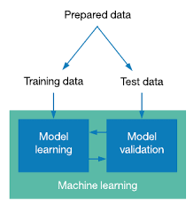
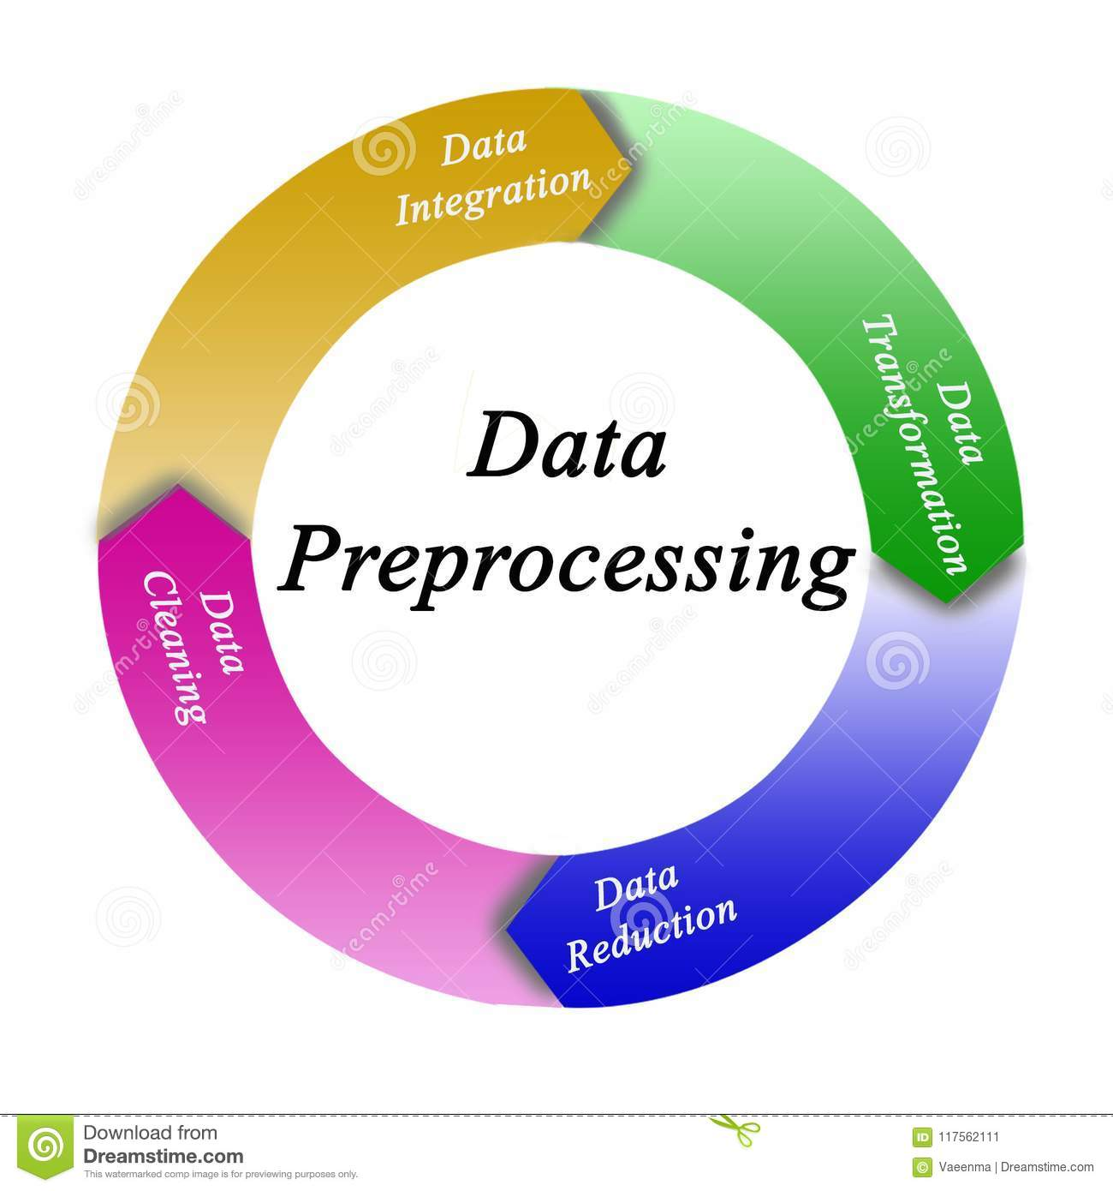
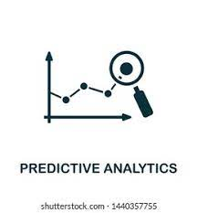

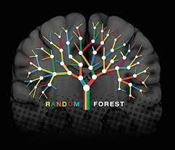
WORKFLOW
Imarticus Learning
Data
Train Test Split
Data pre-processing
Predictions
Evaluation
Random Forest classifier

Slide 8
Methodology
Imarticus Learning
Importing the required libraries and then loading the data set obtained from github in jupyter notebook.
After loading the data it has splitted into train test.
After splitting we have remove all the unnecessary symbol that was present news headline which making our data complex using regular expression.
After that we have converted all upper case letter use in headline to lower case.
After converting to lower case, we renamed the features name as 0,1,2..24.
For easiness we combine all the headlines into one paragraph so that it will be easy to convert it into vectors.
After that we converted all sentences into vectors by importing countvectorizer from sklearn which generally used bag of words.
After that we randomforest algorithm and naïve bayes algorithm for the model and checked the accuracy using confusion matrix.

Slide 9
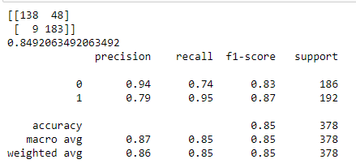
Conclusion
Imarticus Learning
We have used two algorithm i.e, randomforest algorithm and naïve bayes . We will used that model which will provide better accuracy.
Random Forest Accuracy

Slide 10
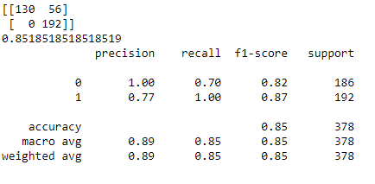
Imarticus Learning
Naive_Bayes Accuracy
We can conclude that naïve bayes algorithm have more accuracy than random forest.

Slide 11
Business Aspects
Imarticus Learning
We find that the inclusion of predictors based on top news articles posts can significantly improve the quality of stock price predictions.
It will be helpful to investors as it provides details when and where to invest to gain good percentage of return(ROI).
It will be too much beneficial for shareholder, consultant ,chartered Accountant and financial companies as they highly depends upon the stock market.
we can prepare a user interface like an app and user can enter the necessary attributes and it will tell the user if he/she would invest or withdraw the money from share market.
There is a scope of model improvement like adding new important attributes or feature engineering or use different ML techniques for modelling to improve the accuracy.

Slide 12
References
Imarticus Learning
Countvectorizer #https://scikit-learn.org/stable/modules/generated/sklearn.feature_extraction.text.CountVectorizer.html Bag of words #https://www.geeksforgeeks.org/bag-of-words-bow-model-in-nlp/ Regular Expressions #https://www.math.purdue.edu/~bradfor3/ProgrammingFundamentals/sklearn/divingdeeper/

Slide 13

THANK Y☺U!!!
Imarticus Learning
YOUR QUESTIONS AND VALUABLE SUGGESTIONS ARE WELCOME
13

